Slide 1
What is an Atom made of?

Slide 2
Outline
Atomic Structure
How to Identify Atomic Structures

Slide 3
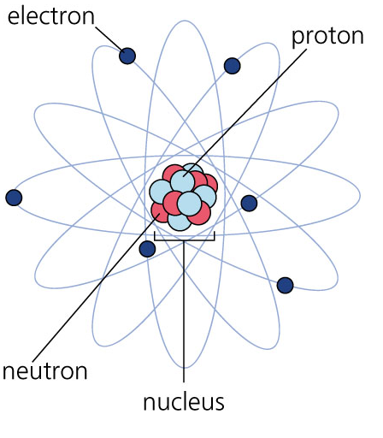

Atomic Structure
Atoms consist of three different subatomic particles:
  Protons
  Neutrons
  Electrons

Slide 4
Atomic Structure
Protons are located in the nucleus of an atom
Protons have a positive
charge

Slide 5
Atomic Structure
Neutrons are located in the nucleus of an atom
Neutrons do not have a
charge (neutral)

Slide 6
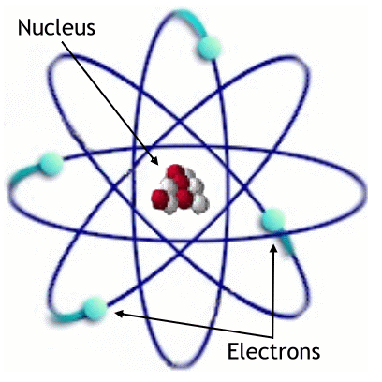
Atomic Structure
Electrons are located outside of the nucleus
Electrons have a
negative charge

Slide 7
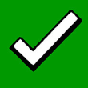
Outline
Atomic Structure
How to Identify Atomic Structures

Slide 8
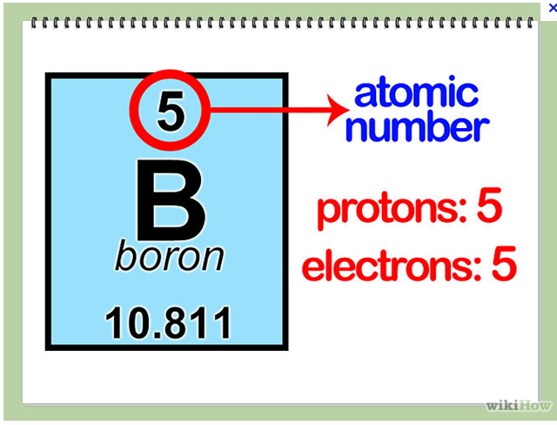
Protons
The # of protons is same as:
  The Atomic Number

Slide 9
Electrons
The # of electrons is same as:
  The Atomic Number

Slide 10
Neutrons
The # of neutrons is determined by:
  Rounded atomic mass - Atomic number
  Eg. Boron
    11 – 5 = 6

Slide 11
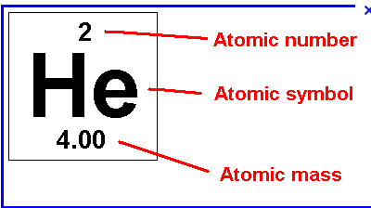
Neutrons
The # of neutrons is determined by:
  Rounded atomic mass - Atomic number
  Eg. Helium
    4 – 2 = 2

Slide 12
Standard Notations
This is another way to write out the element and all the information about it.
It contains 3 steps:
  The Symbol for the element is written out
  Then the Atomic Mass is written at the top left
  Then the Atomic Number is written at the bottom left

Slide 13
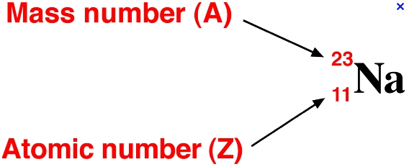
Standard Notations
This is another way to write out the element and all the information about it.
Eg. Sodium

Slide 14
Standard Notations
This is another way to write out the element and all the information about it.
You Try for Oxygen

Slide 15
Outline
Atomic Structure
How to Identify Atomic Structures

